Slide 1



Chandigarh College of Engineering and Technology
(Department of computer science and engineering)
C++ Project on Supermarket Billing System Himanshu Setia

Slide 2

SUPERMARKET BILLING SYSTEM

Slide 3
INTRODUCTION
Supermarket is the place where customers come to purchase their daily using products and pay for that.
There is a need to calculate how many products are sold and to generate the bill for the customer.
So for this we have created a project in c++ of the Supermarket billing system.

Slide 4
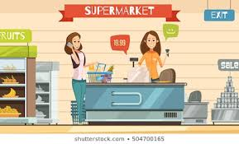
The bill calculating operator will enter the unique code of product then it will show its information and price and the bill will be calculated and total payment will be shown.
Customer will pay for the products.
All the products sold history will be saved in master records file.

Slide 5
DESCRIPTION OF THE PROJECT
Many Supermarkets use this type of billing system for a decade. It is also improved many times according to requirements of sellers and customers
A new concept of editing and searching the goods is added in this project. With the help of this a customer can easily increase or decrease quantity of goods.

Slide 6

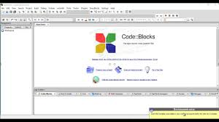
TECHNOLOGY AND TOOLS USED
Code Blocks
C++ Language

Slide 7
HEADER FILES AND FUNCTIONS USED
iostream
windows.h
conio.h
fstream
string
cout
toupper(char)
getch()
SetConsole
gotoxy(int,int)
strcmp(const char *,const char *)
cin
stdio.h
fflush(FILE *stream)
getche()
fout.open()
CursorPosition()
)
system(“cls”)
fin .open()
fout.close()
fin.close()

Slide 8
METHODS AND FUNCTIONS
fstream : - The object declared for this class is fout and fin. It is the predefined class used for both File-to-Memory/Memory-to-File linking.
main() : - This is the main function which is just the MAIN MENU from where the control is transferred to other functions.
gotoxy(int x,int y) :- This function can place cursor at a desired location on screen.
security() :- Security function for operating at billing counter by bill calculating operator.

Slide 9
starting_fun() :-
The starting function of the program which guides the user.
display() :-
Function for displaying options on screen.
search_goods(int num) :-
Function used to search items from the choosen items.
search_goods_sub(int num) :-
This function is part of previous function and it is a continuation of search_goods() function.
add_goods() :-
This function helps to add items to the bill.
heading() :-
Function for displaying heading on screen.

Slide 10
edit_goods(int num) :-
This function edit added items details like quantity, price etc.
edit_goods_sub() :-
It is a continuation of edit_goods() function.
delete_goods(int num) :-
Funtion to delete items from bill.
display_goods(int num) :-
Function to display items on screen.
valid(int opt) :-
Function to check validation of options entered by user.

Slide 11
Benefits OF THIS PROJECT
Saving in labor due to self-service system.
Supermarket has large turnover.
Low cost of operation.
Freedom of selection.
Shopping is very easy and quick

Slide 12


Presented by :- Himanshu Setia & Kunwardeep Singh Gujral (CO19328) (CO19338)

